Slide 1
STUDENT PROJECT · TEAM NO. 52
FLIGHT PRICE PREDICTION
USING LINEAR REGRESSION
DOCUMENTATION
PRESENTATION
Aditya Patil
Nipun Singhal
EXECUTION
VIDEO
Shaurya Kamboj
Jarmik
Project link: github.com/adityapatil1807/Flight-Price-Predictions-

Slide 2
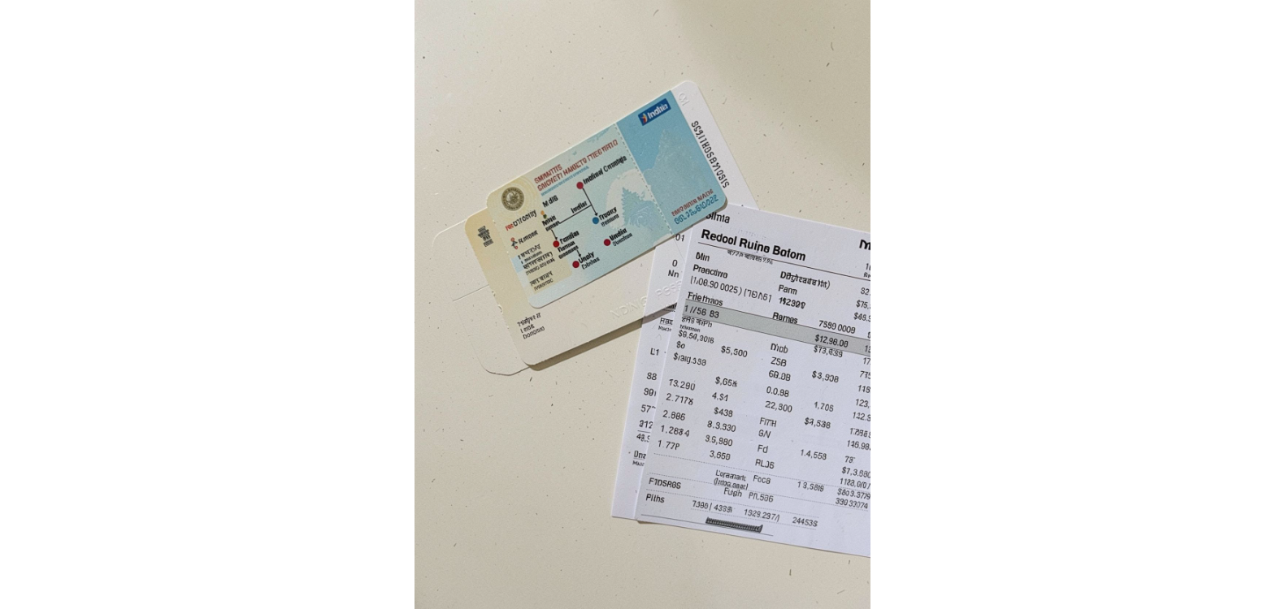



02 · PROBLEM FORMULATION
THE PROBLEM AND DATASET
Goal
Dataset source
Target
Predict a flight ticket price from route, timing, class, and booking lead time.
Kaggle, with flight-ticket data between six Indian cities.
price
Six Indian cities · flight-ticket data · price prediction
MAIN COLUMNS
SELECTED INPUTS
airline · flight · source_city · departure_time · stops · arrival_time · destination_city · class · duration · days_left · price
source_city · destination_city · departure_time · class · days_left

Slide 3
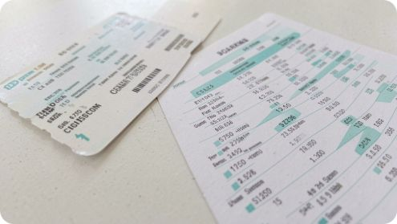
03 · PIPELINE
MODEL ARCHITECTURE & TECHNOLOGIES USED
Input data becomes a repeatable prediction pipeline.
1
2
3
Read
Explore
Prepare
Read and understand the dataset.
Explore price patterns with a histogram, a days-left scatter plot, and average-price comparisons by departure time.
Prepare the data by removing duplicates, handling missing values, and one-hot encoding categorical features.
4
5
Split and train
Evaluate
Split the data into 80% training and 20% testing, then train a Linear Regression model.
Evaluate with MAE, MSE, RMSE, and R², then predict a user flight price from route, time, class, and booking days.
LIBRARIES
pandas · NumPy · Matplotlib · scikit-learn

Slide 4
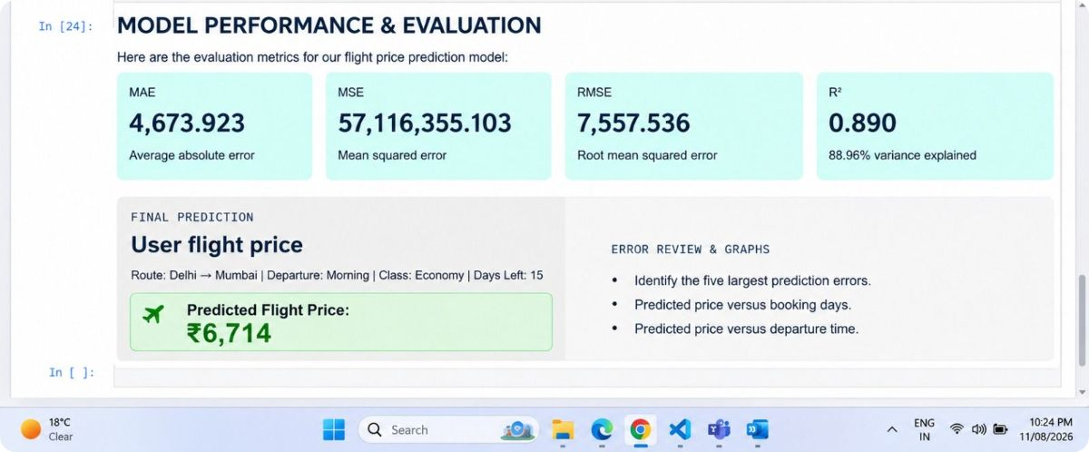
04 · TEST SET EVALUATION
MODEL PERFORMANCE & EVALUATION
Demo Screenshot and Keys Number
MAE
MSE
RMSE
R²
4,673.923
57,116,355.103
7,557.536
0.890

Slide 5
05 · TAKEAWAYS & OWNERSHIP
PROJECT LEARNINGS & TEAM CONTRIBUTIONS
WHAT WE LEARNED
Categorical flight details must be converted into model-ready values.
The model should be tested on data it did not train on.
TEAM CONTRIBUTIONS
Role | Contributor
Documentation | Aditya Patil
Presentation | Nipun Singhal
Execution lead | Shaurya Kamboj
Video | Jarmik
WHAT WORKED
One preprocessing-and-regression pipeline made prediction organized and repeatable.
WHAT DIDN’T WORK AS EXPECTED
The submitted notebook has no executed evaluation output. MAE, MSE, RMSE, R², and the final prediction must be recorded after running it.
AI disclosure: ChatGPT and Claude supported explanations, documentation, and presentation wording; they did not train the model or produce project results.

